Slide 1
Proposed Waiting List Process Changes
Transportation Services Advisory Committee
December 7, 2016

Slide 2
Goals
To be transparent and present what is already occurring.
Present more realistic expectations to help customers.
Ensure more parking lots are available to new employees year round.

Slide 3
Current Process
Customers register for parking/waiting lists during the annual registration period: mid April – mid July.
Employees - Months of Service order
Students - grade classification
Parking is assigned in late July. Unfulfilled requests are added as waiting lists.
Beginning August 1, waiting lists open again and new requests from customers go to the bottom of list according to the date they signed up.
Some DPRs report number of new employees expected.

Slide 4
Concerns with Current Process
Sets unrealistic expectations by allowing customers to sign up for many waiting list they have no chance of receiving.
Receive only partial reporting of the number of new employees expected at the beginning of the fall semester.

Slide 5
Examples
Lot 50 (ETED)
2014
3712 on waiting list after initial assignments
2244 of them still on waiting list at end of year
2015
3911 on waiting list after initial assignments
2632 of them still on waiting list at end of year
Lot 23 (Chemistry)
2014
28 on waiting list after initial assignments
23 of them still on waiting list at end of year
2015
47 on waiting list after initial assignments
33 of them still on waiting list at end of year

Slide 6
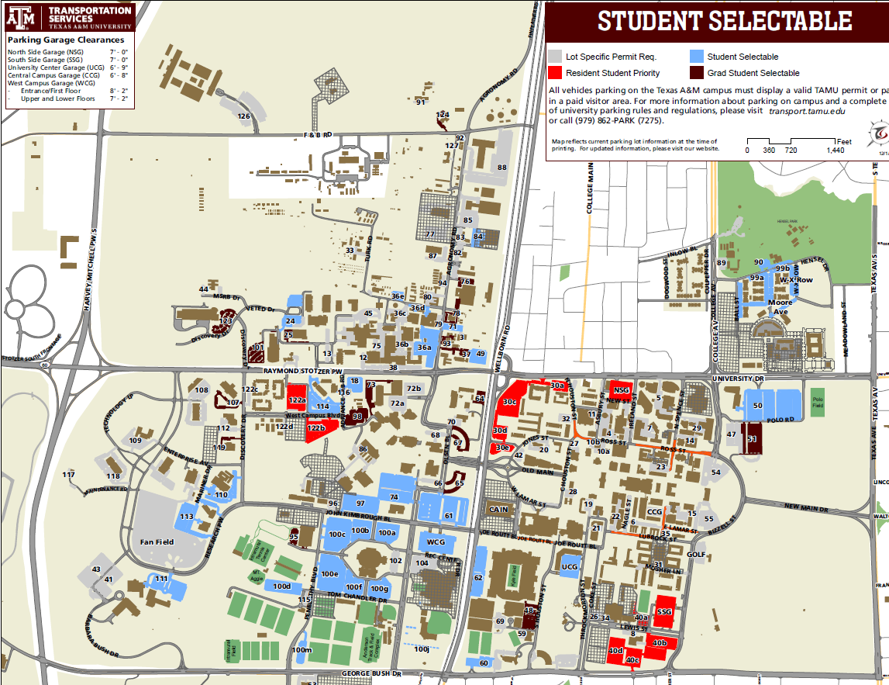

Slide 7
Proposed Changes
Turn off full waiting lists after registration.
Strive to have student lots available year-round to new employees.
NOTE: We already have a process in place to assign permanently disabled customers and executive leadership into lots even with full waiting lists.

Slide 8
Questions?

